Slide 1


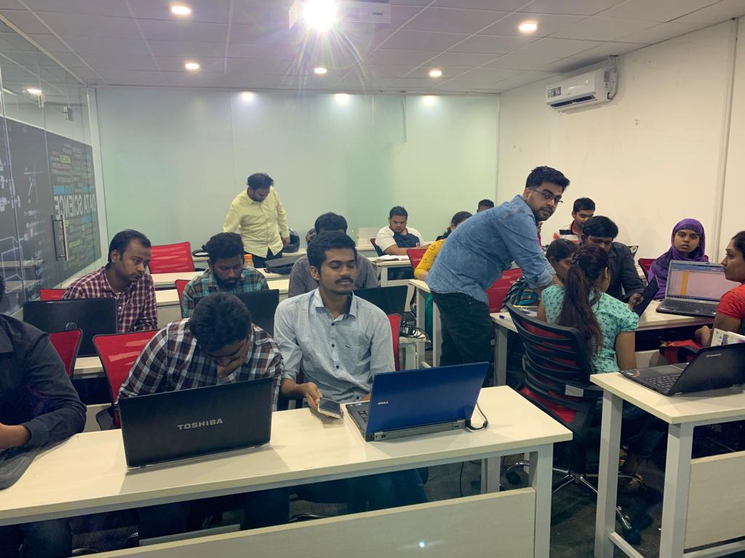





Slide 2
Imdb Rating
Mystery Movies & Series

Slide 3
Problem Statement :
Studies of Movies and Web series based on Genres.
Comparision of Rating on Webseries & Movies
Study of Production Based On certificates
Relationship Between Votes & Certificates..
Scenarios based on Client Requirements

Slide 4
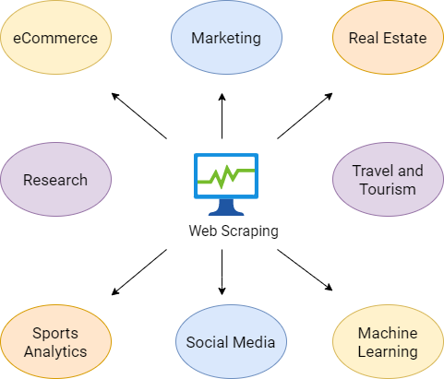
Introduction
What is Web Scrapping ?
Motive of Web Scrapping ?
Use of WebScrapping ?

Slide 5
* Jupyter Notebook
: Libraries Used :--->
Pandas
SOFTWARES USED :
Numpy
BeautifulSoup
requests
matplotlib
seaborn

Slide 6
STEPWISE APPROACH
Topic Selection
Explore Websites
Website Selection
Data Collection
Data Cleaning
Data
Data Visualization

Slide 7
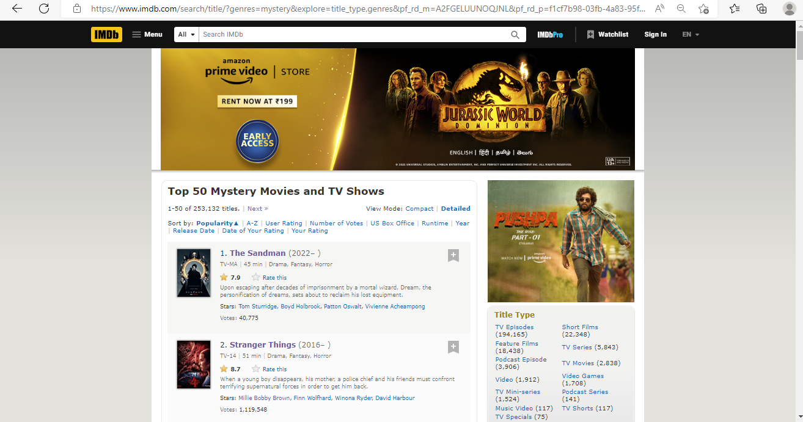
: Website View : 1

Slide 8
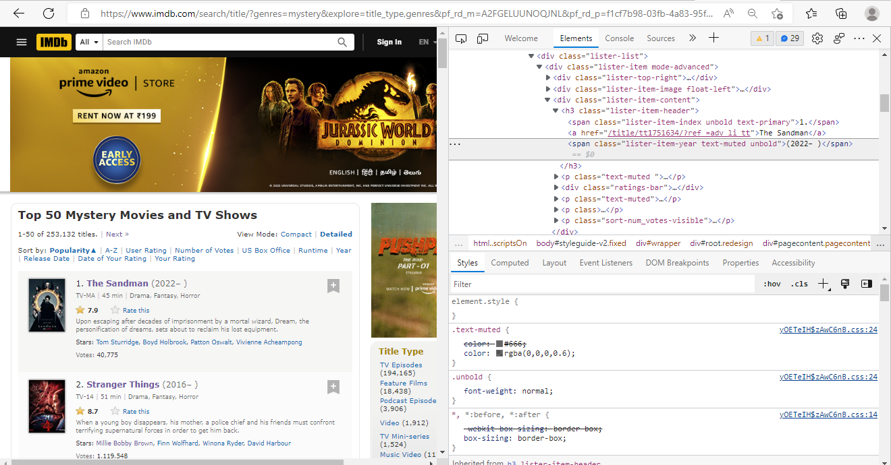
: Website View : 2

Slide 9
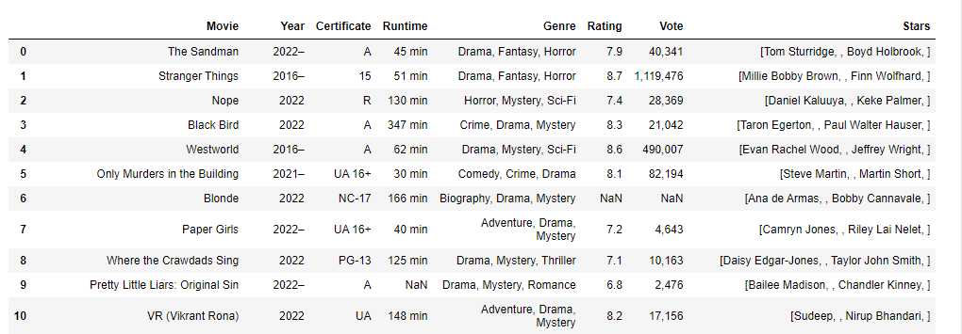
RAW DATA

Slide 10
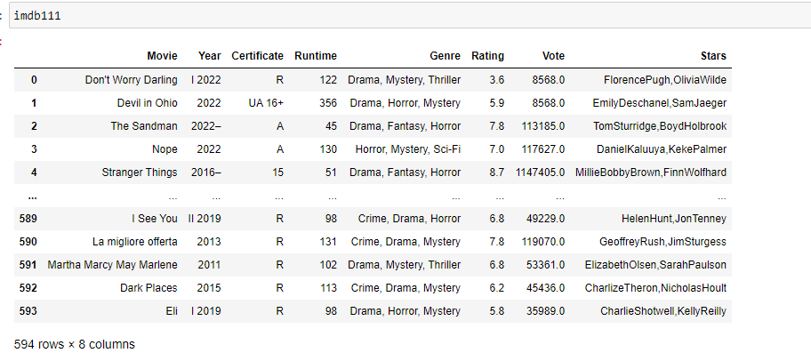
CLEANED DATA

Slide 11
VISUALIZATION
Univariate
Distplot Boxplot
Bivariate
Scatterplot
Regressionplot
Multivariate
Heatmap Pairplot

Slide 12
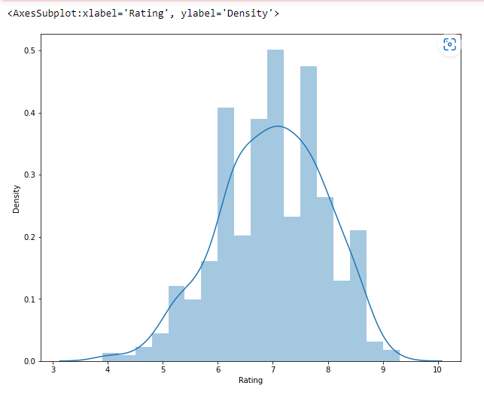
This graph shows us the distribution of rating along with the density
The lowest rating is 3.8 as displayed in the graph and the highest one is 9.2

Slide 13
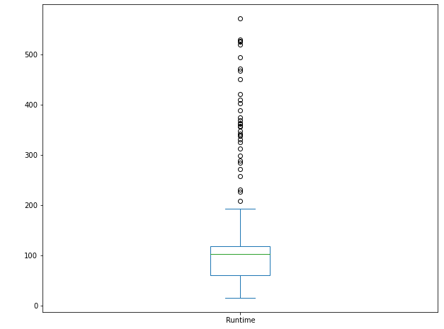
Runtime Graph
The upper and lower whiskers represent Runtime downside from 200 to 0
The median is close to 100

Slide 14
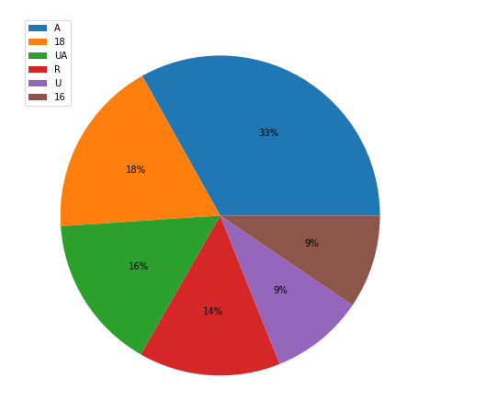
Pie chart shows us the top 6 certificates along with their size in percentages

Slide 15
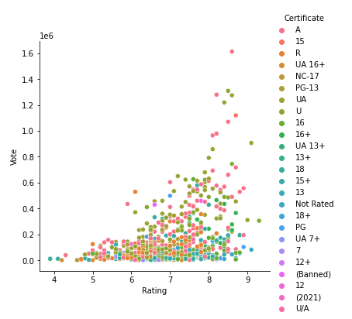
Bivariate analysis looks at two variables and their relationship.
We can see here relationship between vote and rating having different kind of certificates

Slide 16
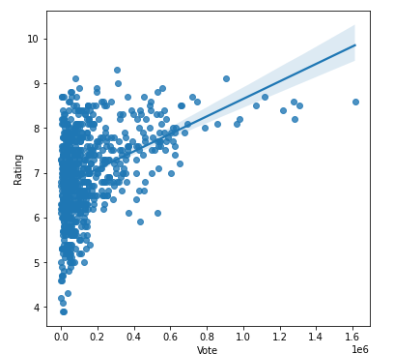
Regression Line graph
Regression line is directly proportional to vote
As the vote increases the regression line passing through rating also increases

Slide 17
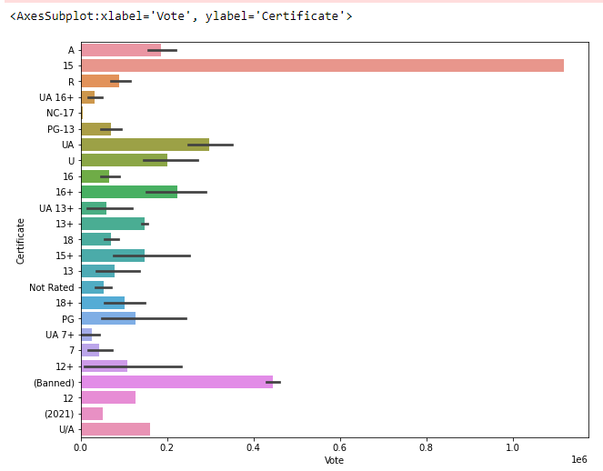
The bargraph shows each certificate along with the vote .
Different kind of certificate having different votes .
The certificate '15' having most no of votes till date
The certificate 'nc-17' having lowest no of votes

Slide 18
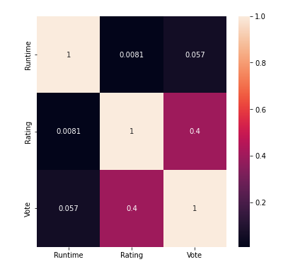
Heatmap Graph
Multivariate analysis is similar to Bivariate analysis but you are comparing more than two variables

Slide 19
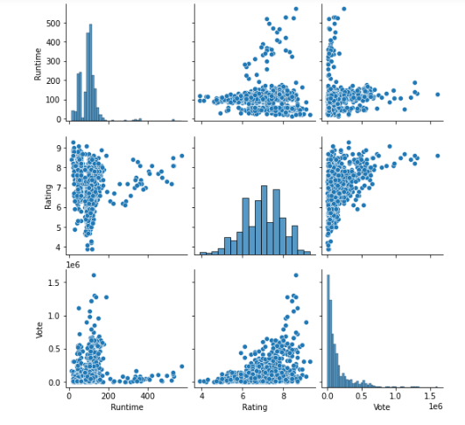

Slide 20
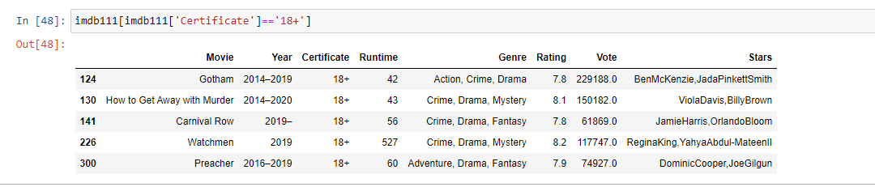
Different Scenarios by Users Choice
1 . If user wants to view movies that are made for 18+ users then -

Slide 21
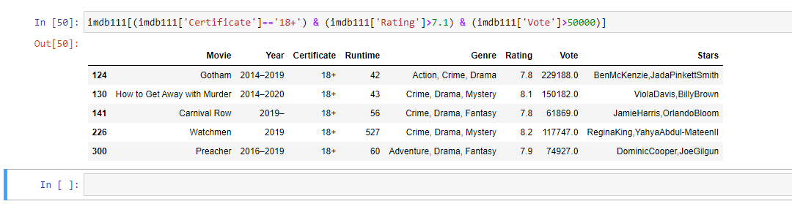
2. if user wants to access movies which has 18+ certificate having good rating of 7.1 and vote greater than 50k

Slide 22
-: CHALLENGES FACED :-
Website Selection -
- Selecting a website which must be Responsive and completes the criteria of data collection (min 400 rows & 10 columns)
Data Collection -
-Collecting data from website followed by column wise data collection approach .which creates many problems like ,accessing data from a class which is not present in many rows ...
Decision Making -
- Which technique is necessary to clean the data ?
- Should I keep it as it is ? Or drop the entire row ? Or other..!!

Slide 23
: Conclusion :
We learnt about movies & web series with respect to different factors such as certificates,votes and much more which affects the rating..
We get to know that which factor affects the rating most ?
We understand how the web Scrapping & Data Analyzation works and how to visualize that data and collect meaningful Insights from that data

Slide 24

THANK YOU

